Slide 1
SEMANTIC
REVIEW 1
ANALYZER
Developing a semantic analyzer for a simple programming language that performs type checking,
declaration checking, scope checking, and validation of assignment and expression statements.
SHREYAN KAUSHIK (24BCE2049)
VAIBHAV BAKSHI (24BCE2052)
KARELIYA MEET BINDESHKUMAR (24BCE2053)
Notes:
Review 1: original 25% milestone presentation. Original project descriptions and screenshots reflect this earlier review.

Slide 2
INDEX
Objective
Overview
Project Architecture
Key Features & Functions
Working of the Program
Example Test Cases
Future Scope

Slide 3
OBJECTIVE
To develop a semantic analyzer for a simple programming language that performs type checking, declaration
checking, scope checking, and validation of assignment and expression statements.
Our first milestone works on establishing a working pipeline that can:
Read source code from a text file.
Recognize the language’s tokens.
Track each token’s location.
Skip whitespace and comments.
Identify unrecognized characters.
Present token information and explanatory lexical diagnostics.

Slide 4
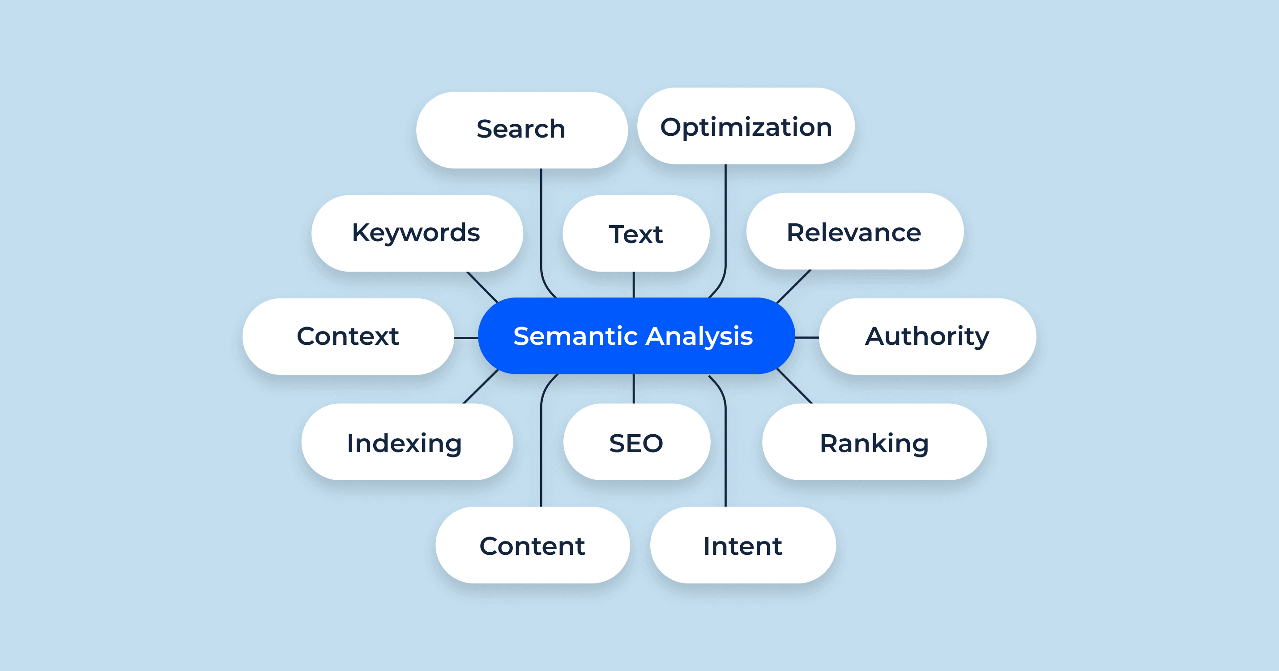
OVERVIEW
The project is a compiler front end
implemented in C++17. Its overall
purpose is to examine source code
and identify errors involving
declarations, variable scopes, types,
expressions, function calls, and return
values.
It currently demonstrates lexical analysis, which converts source text into the tokens required by subsequent
compiler stages.

Slide 5
PROJECT ARCHITECTURE
Component | Use:
src/Token.hpp | Defines token categories and stores each token’s text, line, and column.
src/Lexer.hpp | Declares the lexer’s interface and scanning state.
src/Lexer.cpp | Implements token recognition, comment skipping, and position tracking.
src/main_1.cpp | Reads the source file, invokes the lexer, and displays results and diagnostics.
tests/review_1_tests/ | Contains the three demonstration inputs.
scripts/build.ps1 | Builds the three milestone executables.
build/review_1.exe | The compiled program that accepts a source-file path.
semantic-analyzer/
+ src/
+ Token.hpp
+ Lexer.hpp
+ Lexer.cpp
+ main_1.cpp
+ tests/review_1_tests/
+ test1_declarations.txt
+ test2_operators.txt
+ test3_unknown_character.txt
+ scripts/build.ps1
+ build/review_1.exe

Slide 6
KEY FEATURES & FUNCTIONS
Keyword recognition:
Identifies reserved language words.
int, float, bool, if, return
Identifier recognition:
Identifies names used in source code.
count, price, total
Literal recognition:
Recognizes integer, decimal, and character literals.
10, 2.5, 'A’
Operator recognition:
Recognizes arithmetic, assignment, comparison, and logical operators.
int, float, bool, if, return
Delimiter recognition:
Recognizes punctuation and grouping symbols.
; , ( ) { }

Slide 7
KEY FEATURES & FUNCTIONS
Whitespace handling
Skips spaces, tabs, and line breaks while tracking positions.
Spaces between declarations
Comment handling
Skips single-line and block comments.
//comment , /*comment*/
Position tracking
Records where each token begins.
Line 1, column 5
Unknown-character detection
Produces an error for unsupported characters.
@
EOF generation
Marks the end of the input.
EOF

Slide 8
WORKING OF THE PROGRAM
Source Code
Text File
File reading and
byte-count
checking
Lexer scans
characters
Explanatory
diagnostics and
summary
Token table
Token sequence
with source
positions

Slide 9
WORKING OF THE PROGRAM
The lexer maintains a current character index, line number, and column number. It examines characters to determine
whether they begin an identifier, number, character literal, operator, or delimiter.
For two-character operators such as >= and &&, it examines the following character before deciding which token to
produce.
When an occur, the following information is received:
The error’s line and column.
The relevant source line.
A caret pointing to the offending character.
An explanation.
A possible correction.

Slide 10
WORKING OF THE PROGRAM
Input and output:
Token Table
Column | Meaning
Line | Source line where the token begins, numbered from 1.
Column | Character position where the token begins, numbered from 1.
Token | Token category; operators and delimiters use their symbols as labels
Lexeme | Token text; character literals are displayed without surrounding quotes.
The input is a .txt file containing source code in the
project’s C-like language.
The output contains:
Input filename.
Number of bytes read.
Token table.
Explanatory lexical diagnostics, when applicable.
Token count excluding EOF.
Lexical-error count.

Slide 11
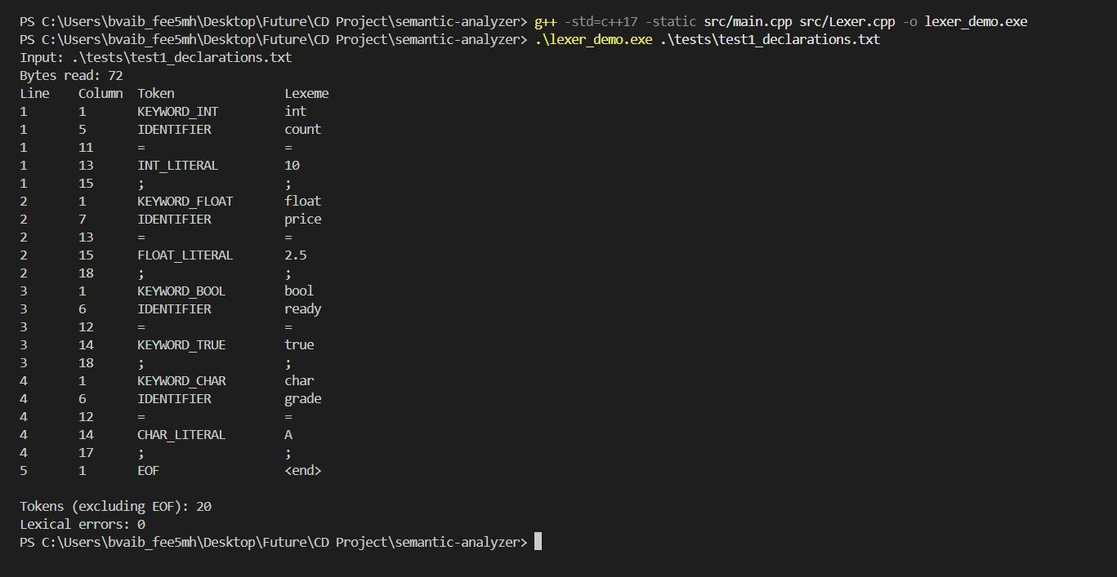
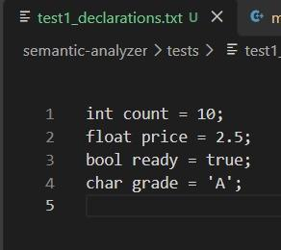
TEST CASE 1
VALID DECLARATIONS

Slide 12
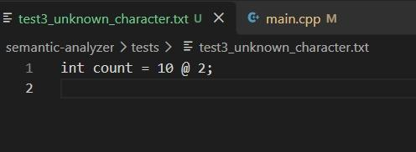
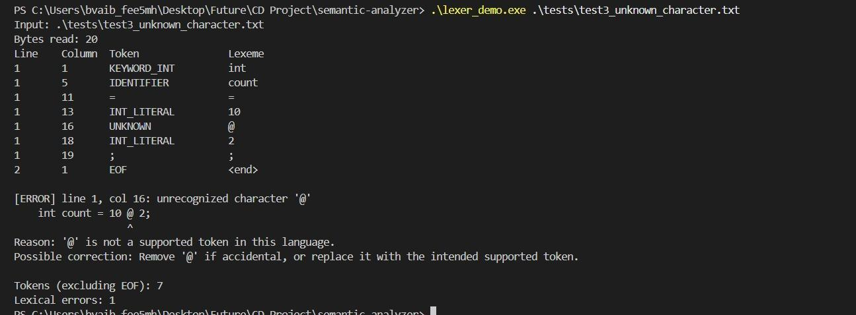
TEST CASE 2
INVALID CHARACTER

Slide 13
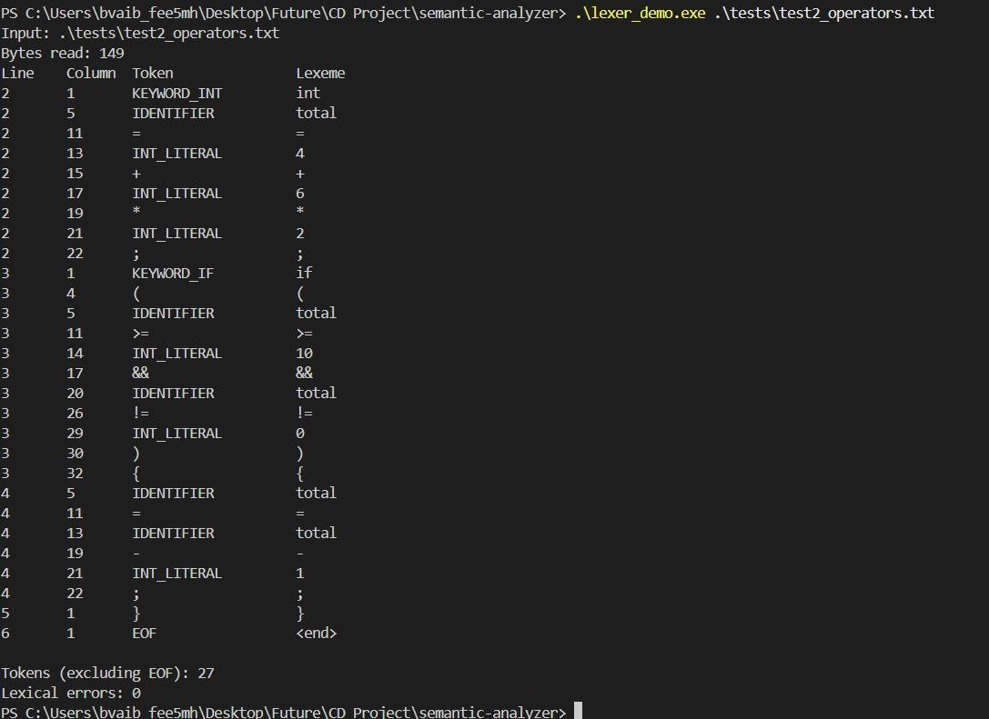
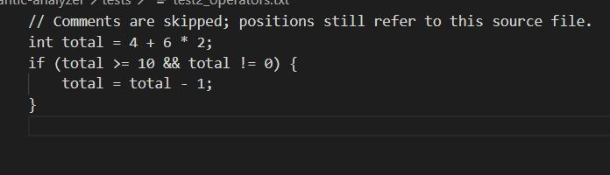
TEST CASE 3
OPERATORS & COMMENT HANDLING

Slide 14
FUTURE SCOPE
The complete project’s parser, AST, type system, symbol table, semantic analyzer, and original supporting files remain preserved in later/. That folder is ignored by Git and excluded from the active build.
The current milestone does not validate grammar, resolve declarations, check type compatibility, evaluate expressions, or execute input programs. For example, int count = true; can tokenize successfully even though it contains a semantic type mismatch.
Stricter validation of malformed character literals and unfinished block comments also remains pending. The current deliverable is a working lexical-analysis demonstration with source-position tracking, readable output, and explanatory unknown-character diagnostics.
Notes:
Historical Review 1 scope. These future compiler stages are implemented in the separate Review II presentation. The old archive and filenames reflect the original PDF snapshot.

